Slide 1
IMPROV 3.0
Lorelie Miranda
Annielyn Gerodias

Slide 2
CONTENTS
IMPROV Introduction
Vlocity and IMPROV
Vlocity and IMPROV’s Integration Points
Changes from IMPROV 2.0 to IMPROV 3.0
IMPROV 2.0 Architecture
IMPROV 2.0 Re-architecture Plan
IMPROV 3.0 Final Architecture
IMPROV 3.0 Network Diagram
IMPROV 3.0 Environment Set Up and Specifications
GCP Components
IMPROV 3.0 APIs
Dependencies

Slide 3
IMPROV Introduction
IMPROV is part of the Order to Cash, Buy-Flow process at Lumen. The application is triggered by Vlocity during its order management processes.
When customers want to order service, they do it in Salesforce and then Salesforce communicates with Vlocity. Vlocity gathers all the information needed to be sent to the customers equipment. Vlocity uses IMPROV to send the data to the customers equipment. IMPROV's role is to collect data from Vlocity then transmit it along the way to the customer equipment with validation, call to LDAP, etc.

Slide 4
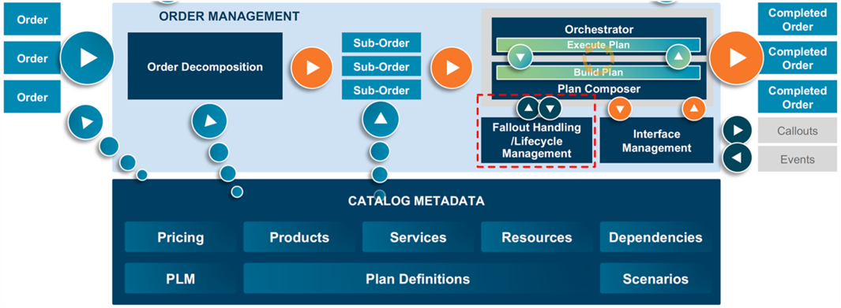
Vlocity and IMPROV 3.0
Order Management Architecture
As mentioned in the introduction, Vlocity is the one who triggers IMPROV during its Order Management process, specifically during the Orchestration Process.
Orchestration Process

Slide 5
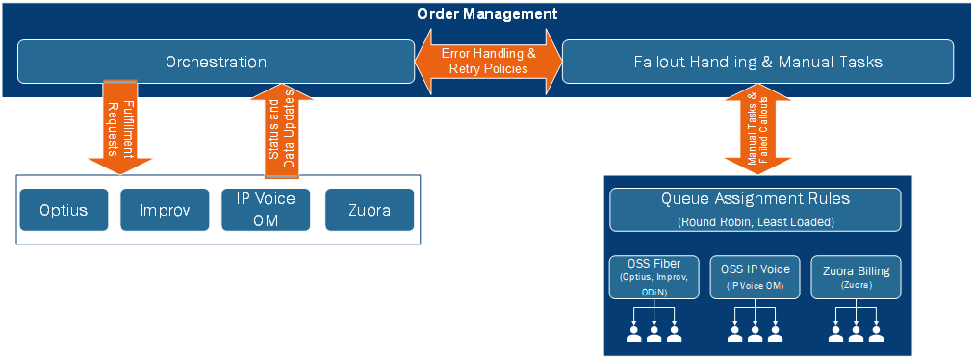
Vlocity and IMPROV
Order Orchestration and Fallout Handling
IMPROV is part of the Order Submit Flow before provisioning because it handles creation of CPE Credentials in the process.
Aside from the order submit flow, it is more often triggered during Order Fallout Handling, or what we call Unhappy Scenarios.

Slide 6
Vlocity and IMPROV’s Integration Points
Here is a list of Scenario’s where Vlocity triggers IMPROV during its process flow
Process | Part/Scenario | Flow
New Install BuyFlow | N/A | N/A
Order Submit | Before Provisioning | [Apigee/GCP] Send Required details to IMPROV -> [IMPROV] Create CPE Credentials -> [Apigee/GCP] Handles the Response, and then provision
New Install -Tech Install | N/A | N/A
Unhappy Scenarios | Cancel Order before Activation | [Apigee/GCP] Initiate Cancelation of HSI -> [Apigee/GCP] Send Delete to IMPROV for HSI -> [IMPROV] Delete HSI Account
 | Active Customer Changes Product | [Apigee/GCP] Initiate upgrade/Downgrade APIs -> [Apigee/GCP] Update Speed Profile IMPROV -> [IMPROV] Update New HSI Speed
 | Suspend due to non-pay | [Apigee/GCP] Decompose suspend calls to OSS Systems -> [Apigee/GCP] Request Suspend to IMPROV -> [IMPROV] HSI set to suspend state
 | Resume due to non-pay | [Apigee/GCP] Decompose resume calls to OSS Systems -> [Apigee/GCP] Request Resume to IMPROV -> [IMPROV] HSI set to resume state
 | Disconnect | [Apigee/GCP] Initiate disconnect of HSI -> Send Delete to IMPROV for HSI -> [IMPROV] Delete HSI Account

Slide 7
Changes from IMPROV 2.0 to IMPROV 3.0
From the previous implementation, IMPROV 2.0 resides in the Lumen Network, part of OSS.
For IMPROV 3.0, it will be split into two parts: the IMPROV 3.0 Controller (resides in the Cloud) and IMPROV 3.0 Comm (resides in the Lumen Network)
Comm’s job is to Communicate to the LDAP part of Lumen Network, while the Controller keeps the other functionalities of the previous implementation.

Slide 8
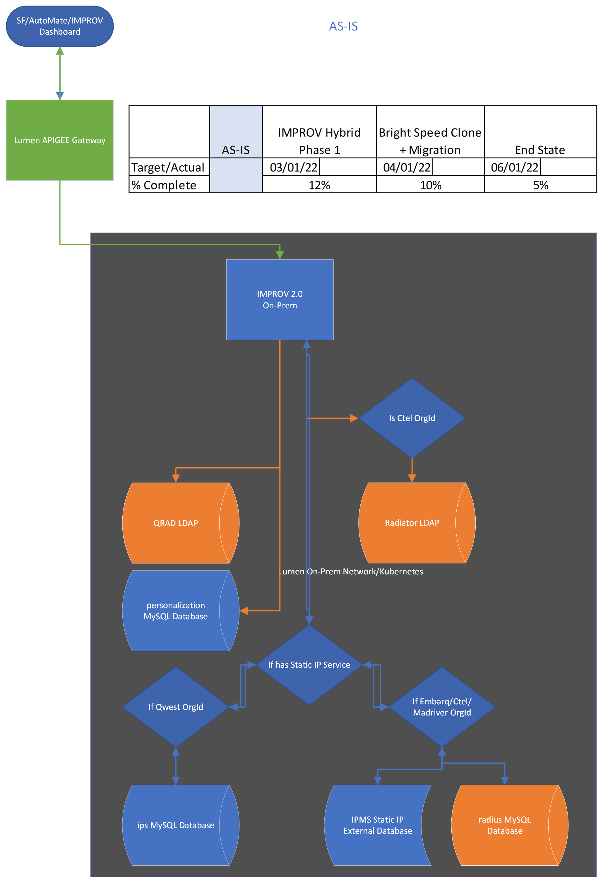
IMPROV 2.0 Architecture
IMPROV AS-IS.vsdx (accenture.com)

Slide 9
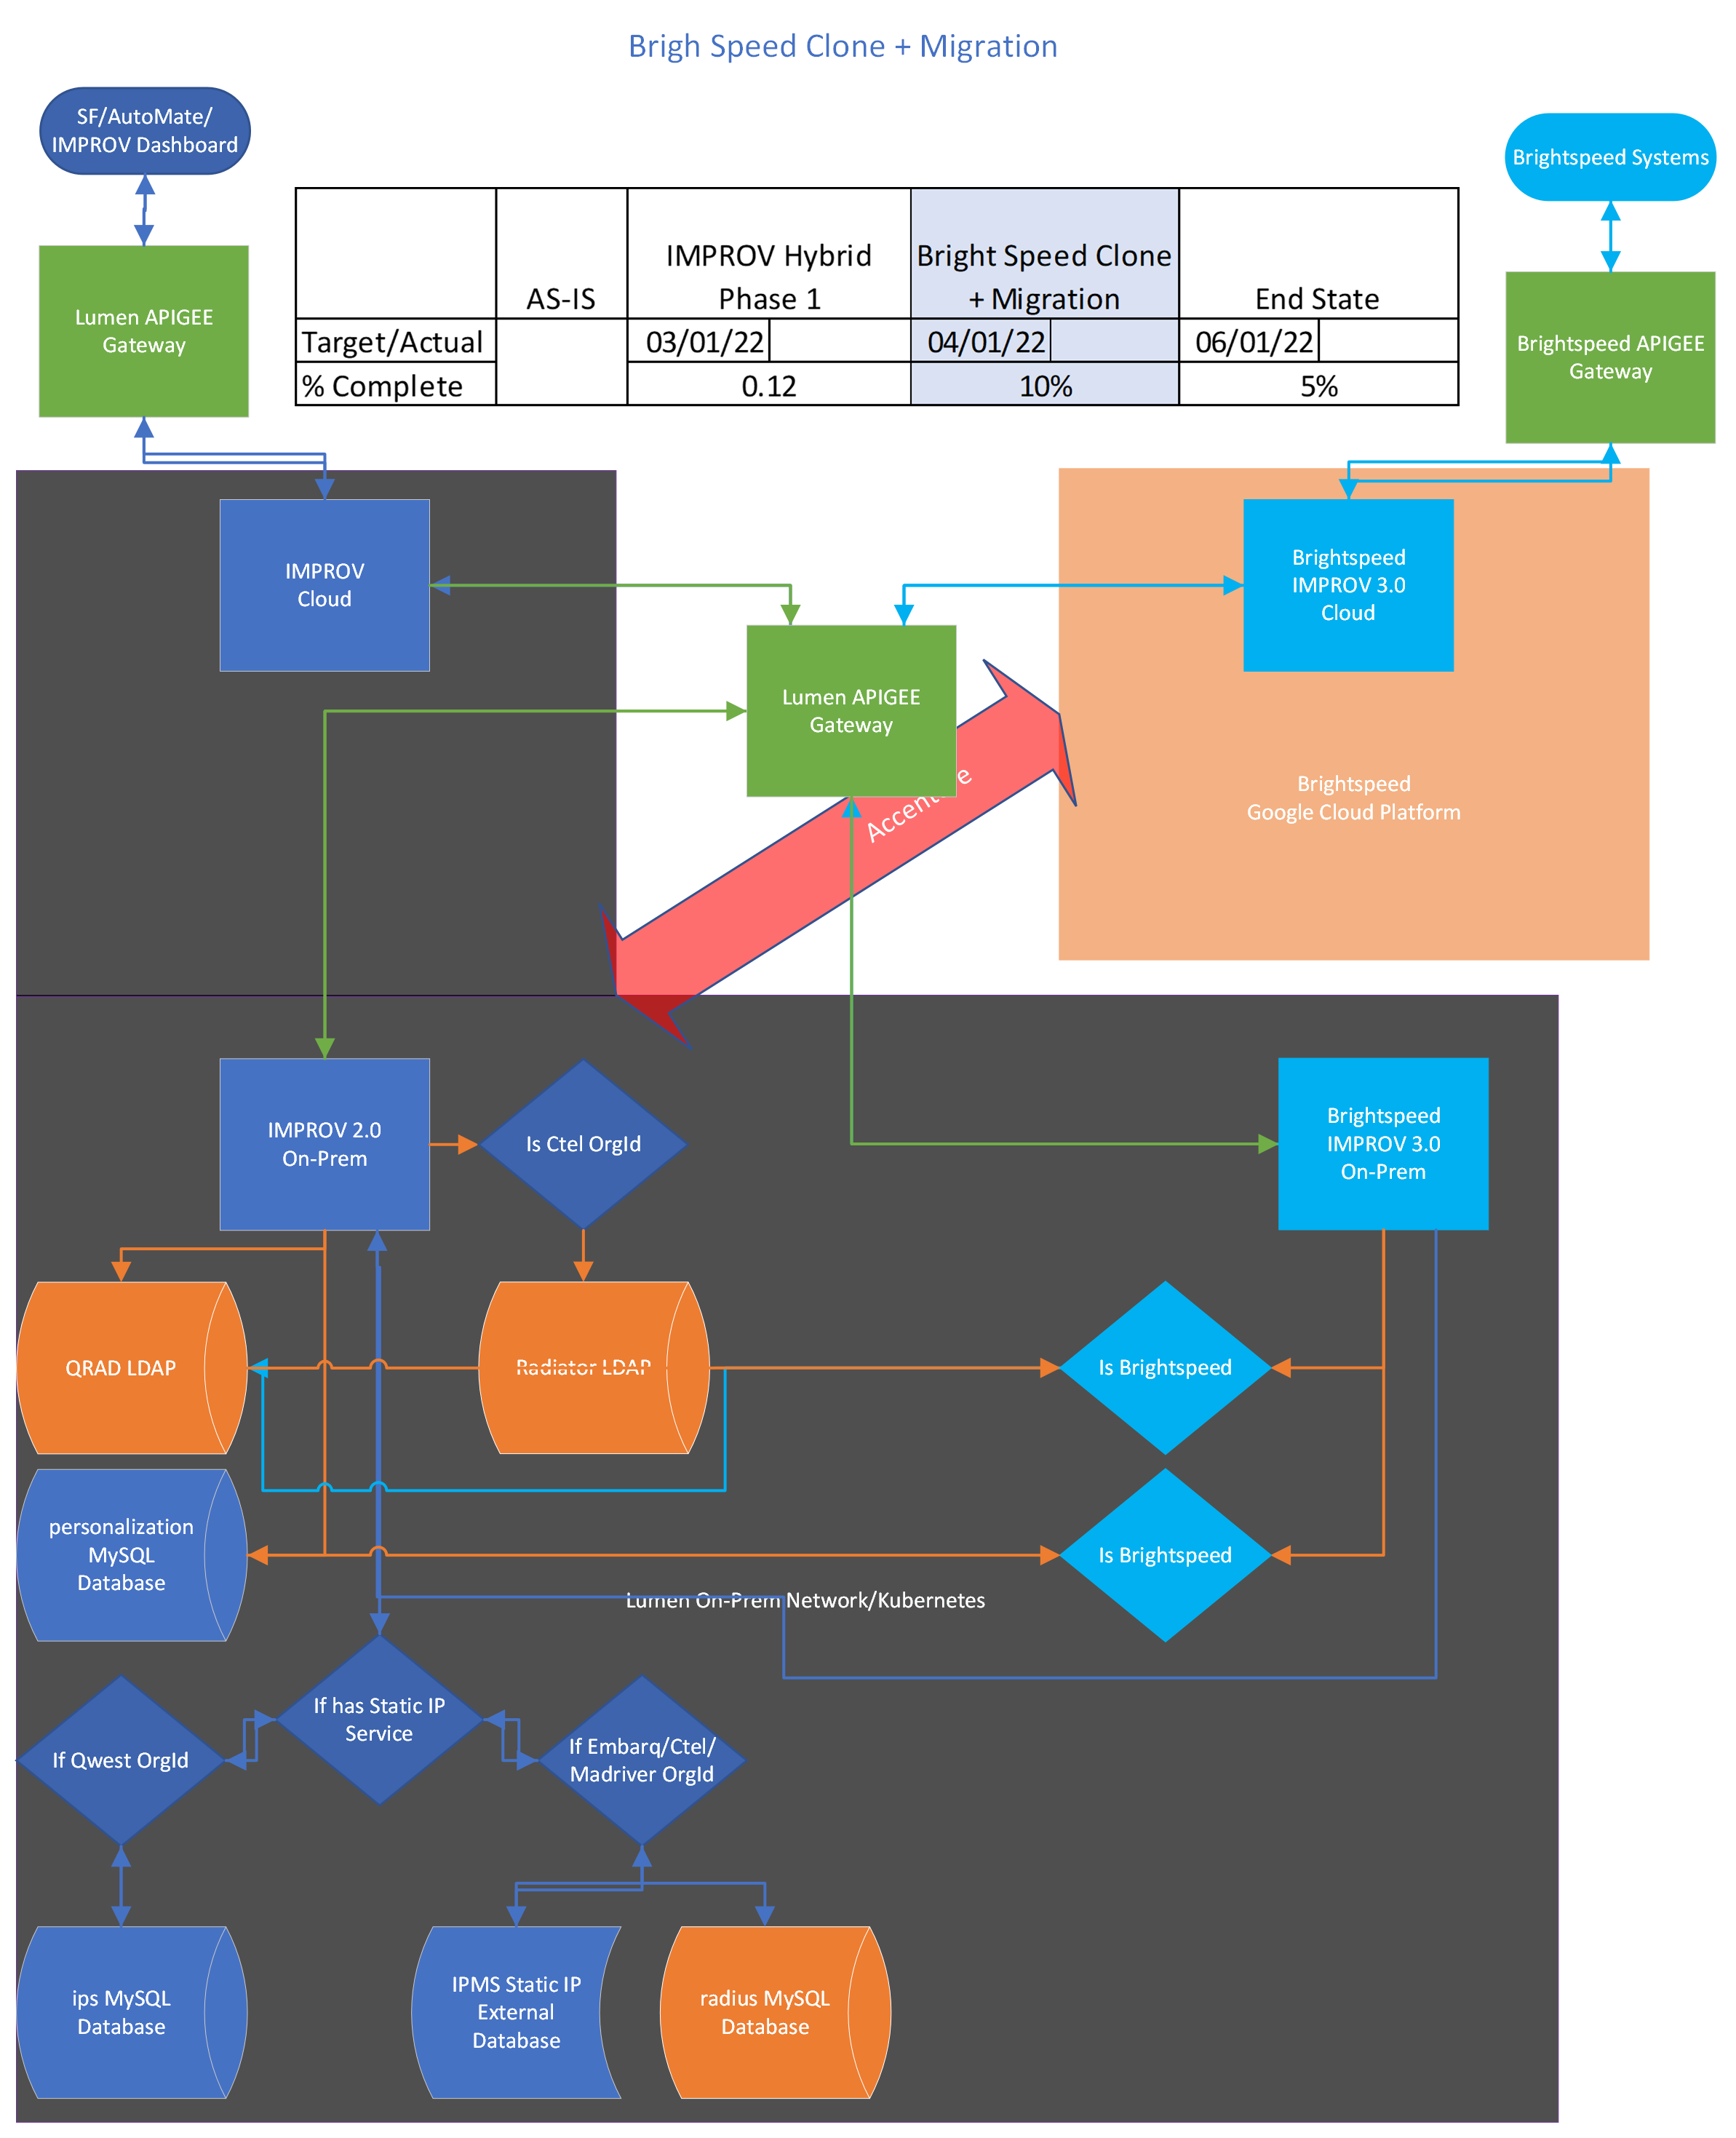
IMPROV 2.0 Re-architecture Plan
IMPROV-BrightSpeed-Clone.vsdx (accenture.com)

Slide 10
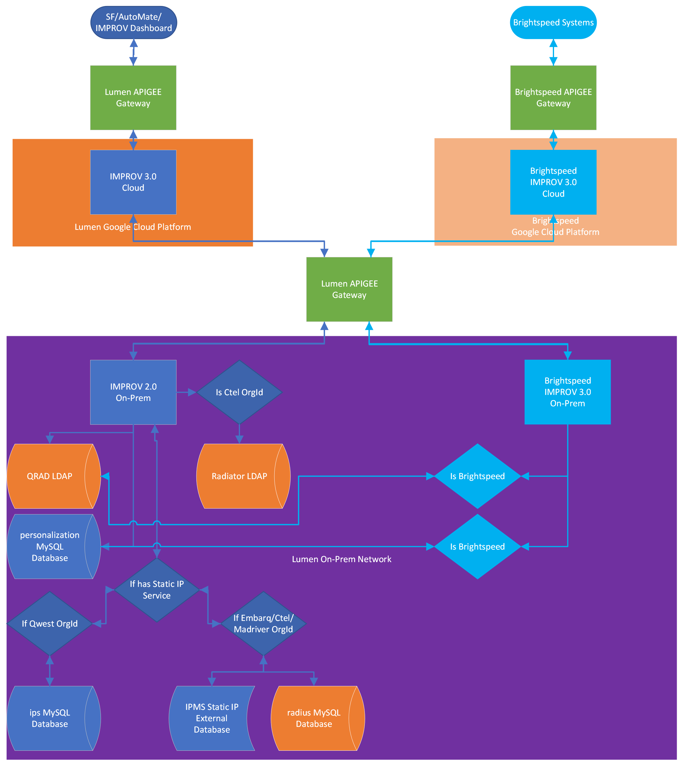
IMPROV 3.0 Final Architecture
IMPROV 2.0 Flow Diagram V3.vsdx (accenture.com)

Slide 11
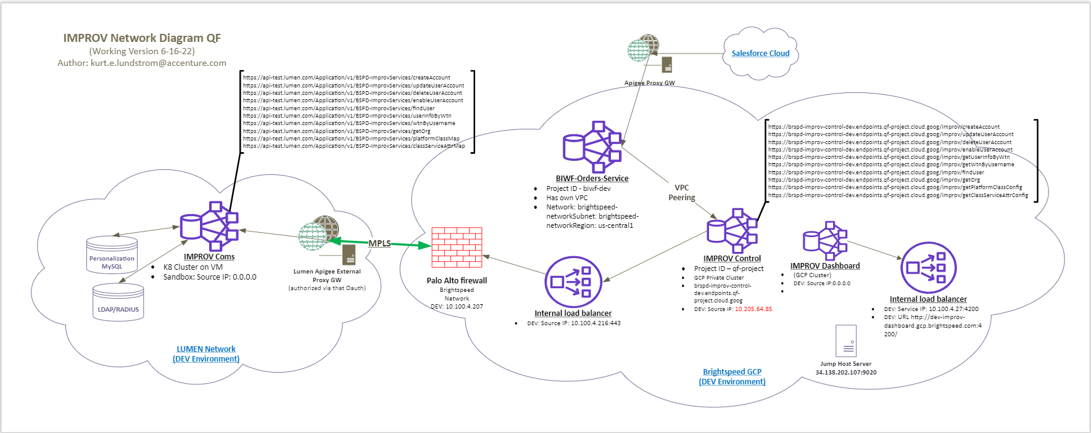
IMPROV Network Diagram
Note: This Diagram is still a work in progress, updates will be available in the IMPROV Sharepoint.

Slide 12
IMPROV- Control Environment Set-up and Specifications
 | Dev | Test
GCP Project | qf-project(us-east1) | bs-prj-improv-uat-01(us-east4)
Cluster Name | improv-control-dev-pvt-cluster-1 | bs-prj-improv-uat-01-improv-gke-pvt-01
Load Balancer IP | 10.100.4.74:443 | 10.124.10.34:443
Repository | Brightspeed-TechM/brspd-improv-control: IMPROV Repo (github.com)

Slide 13
GCP Components
CloudBuild Trigger
improv-control-master-trigger
Improv-control is deployed using Google CloudBuild. This is automatically executed by this trigger
Cloud Endpoint
brspd-improv-control-dev.endpoints.[Project_ID].cloud.goog/improv
This endpoint is used to access Improv-control services
Secret Key and Certification
Improv-control endpoint is secured by a secret key and certificate created in GCP
CRT-nginx-crt-improv-control-dev
KEY-nginx-key-improv-control-dev
API Key
APIs of improv control are protected by API key. External services accessing the APIs are required to provide the API key in sending request.
brspd-Improv-Control-API-key

Slide 14
Improv 3.0 APIs
Improv-Control | Improv-Comms
https://brspd-improv-control-dev.endpoints.qf-project.cloud.goog/improv | https://api-test.lumen.com/Application/v1/BSPD-ImprovServices
/getUserInfoByWtn | /userInfoByWtn
/getWtnByUsername | /wtnByUsername
/getPlatformClassConfig | /getPlatformClassConfig
/getClassServiceAttrConfig | /getClassServiceAttrConfig
/findUser?username= | /findUser?username=
/findUser?WTN= | /findUser?WTN=
/deleteUserAccount | /deleteUserAccount
/updateUserAccount | /updateUserAccount
/createAccount | /createAccount
/enableUserAccount?username= | /enableUserAccount?username=
/getOrg | /getOrg

Slide 15
Dependencies
Connection to Lumen External Apigee
Improv-control is connected to Improv-comms via Lumen Apigee Gateway. An application is created for Improv in their API Marketplace and provides the consumer key and consumer secret.

